Slide 1
IST772 Bayesian Inference (Week 5)
Copyright 2019, Jeffrey Stanton
Pre-class activity:
You have disproved the null hypothesis (that is, the hypothesis of no difference between the population means).
You have calculated the probability of the null hypothesis being true.
You have proved your experimental hypothesis (there is a difference between the population means).
You can deduce/calculate the probability of the experimental hypothesis being true from the provided results.
Assuming you decide to reject the null hypothesis, you know the probability that you are making the wrong decision.
You have a reliable experimental finding in the sense that if, hypothetically, you repeated the experiment many times, you would obtain a significant result on 99% of the replications.
Send me a private chat message indicating which, if any, of these statements is false. It is possible that more than one statement is false.
The following problem is modified from Haller and Krauss (2002): “Suppose you have a drug that you suspect may alter performance on a certain task. You compare the means of control and experimental groups (n=20 in each group). Further, suppose you use the independent means t-test and your result is (t = 2.7, df=18, p=0.0112). Consider these six interpretations of your results:

Slide 2
Topics / Learning Goals
Bayesian Thinking about Data
Bayes’ Theorem
Markov Chain / Monte Carlo Method
Posterior Distribution of Mean Differences / Highest Density Interval
The Null Hypothesis Significance Test
Learning goal: At the conclusion of this chapter/class, students should be able to describe the high level logic of Bayesian inference and use R or another tool to generate and review a posterior distribution of a statistic.

Slide 3
Remember: The 95% in CI Refers to a Process, Not Your Results
The chances that this final constructed interval contains the population value are zero.

Slide 4

Bayes Theorem: I have a fever. . . Do I have the flu?
The formula for Bayes theorem:
$$p\left(H | D\right)=\frac{p\left(D | H\right)p(H)}{p(D)}$$
Posterior: The probability that I have the flu, given that I do have a fever.
Prior: The probability that any particular person has the flu.
Likelihood: For people who have the flu, the probability that fever is an active symptom.
Evidence: The probability of having a fever, regardless of the cause.
In practice, using multivariate/metric data instead of simple event counts, the denominator cannot be directly calculated, as its definition contains an integral with no closed form expression. We therefore must use an iterative computational technique to estimate p(D). This is the purpose of MCMC estimation.
Notes:
The sidebar in the book talks about the Bayes equation as a way of converting prior beliefs into posterior probabilities using new data. The prior belief in the toast scenario is the marginal probability of jelly AKA p(jelly): With no other knowledge, the proportion of jelly toast is 0.3. So if we had to guess without being given any new data, we would just guess 0.3. But we do have new data and we can use that new data to calculate a value that will transform our prior belief (0.3) into a posterior probability. Intuitively, one can observe from the top row of data that of the two outcomes for jelly toast, toast-down is favored (0.2/0.3=0.667) versus toast-up (0.1/0.3=0.333), so we will be looking to “scale up” our guess (meaning our scaling factor will be larger than 1). Keep in mind that although toast-down is favored versus toast-up for jelly, that in the grand scheme of things toast-down only occurs half the time. Taking all of that into account, the scaling factor is 0.667/0.5 = 1.3334. So we can now update our prior belief 0.3 * 1.3334 = 0.4. Knowing that the toast-is-down increases the likelihood that the toast is jelly by a factor of 1.3334.

Slide 5

Bayes Theorem: I have a fever. . . Do I have the flu?
Posterior = (Likelihood * Prior ) / Evidence
OR
The probability of the hypothesis given the data is equal to the probability of the data given the hypothesis multiplied by the probability of the hypothesis divided by the probability of the data
The formula for Bayes theorem:
$$p\left(H | D\right)=\frac{p\left(D | H\right)p(H)}{p(D)}$$
In practice, using multivariate/metric data instead of simple event counts, the denominator cannot be directly calculated, as its definition contains an integral with no closed form expression. We therefore must use an iterative computational technique to estimate p(D). This is the purpose of MCMC estimation.
Notes:
The sidebar in the book talks about the Bayes equation as a way of converting prior beliefs into posterior probabilities using new data. The prior belief in the toast scenario is the marginal probability of jelly AKA p(jelly): With no other knowledge, the proportion of jelly toast is 0.3. So if we had to guess without being given any new data, we would just guess 0.3. But we do have new data and we can use that new data to calculate a value that will transform our prior belief (0.3) into a posterior probability. Intuitively, one can observe from the top row of data that of the two outcomes for jelly toast, toast-down is favored (0.2/0.3=0.667) versus toast-up (0.1/0.3=0.333), so we will be looking to “scale up” our guess (meaning our scaling factor will be larger than 1). Keep in mind that although toast-down is favored versus toast-up for jelly, that in the grand scheme of things toast-down only occurs half the time. Taking all of that into account, the scaling factor is 0.667/0.5 = 1.3334. So we can now update our prior belief 0.3 * 1.3334 = 0.4. Knowing that the toast-is-down increases the likelihood that the toast is jelly by a factor of 1.3334.

Slide 6
Contingency Tables Assist with Bayesian Thinking
 | Down | Up | marginal
Jelly | 0.2 | 0.1 | 0.3
Butter | 0.3 | 0.4 | 0.7
marginal | 0.5 | 0.5 | 1.0
Bayesian thinking describes how we update our probabilities given new information.
There's a piece of toast lying on the ground with the topping facing down, what's the probability that the topping is jelly?
Observing toast down gives new information.
New information updates our beliefs about jelly and butter.
p(jelly|down) – The probability of observing jelly, given that the toast is facing down.
p(jelly|down) = 0.2 / 0.5 = 0.4 (using the marginal calculation method from chapter 2)
Notice that p(down|jelly)=0.2/0.3, where the denominator is the marginal probability of jelly.

Slide 7
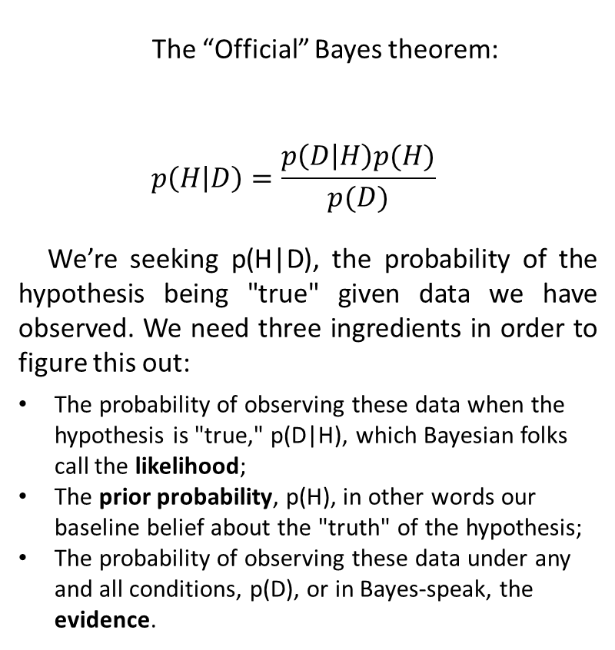
Bayes Theorem: Same Thinking, New Formula
The “Official” Bayes theorem:
$$p\left(H | D\right)=\frac{p\left(D | H\right)p(H)}{p(D)}$$
We’re seeking p(H|D), the probability of the hypothesis being "true" given data we have observed. We need three ingredients in order to figure this out:
The probability of observing these data when the hypothesis is "true," p(D|H), which Bayesian folks call the likelihood;
The prior probability, p(H), in other words our baseline belief about the "truth" of the hypothesis;
The probability of observing these data under any and all conditions, p(D), or in Bayes-speak, the evidence.
Our Toast Example: What's the probability that the topping is jelly, given that the toast is down?
p(down | jelly) * p(jelly)
p(jelly | down) = -------------------------------------
p(down)
The probability of observing toast down, given it is jelly: p(down | jelly) = 0.2/0.3 = 0.667 (where the 0.3 is the marginal total for jelly)
Then, p(jelly) is the marginal total for jelly (0.3)
And p(down) is the marginal for toast down (0.5)

Slide 8
MCMC Estimation – Metropolis-Hastings Demo
A Markov Chain is a series of linked values where the value of t+1 depends only on the value of t
A Markov “kernel” defines the transition between value t and value t+1
The Metropolis-Hastings algorithm is one such kernel: We can model an arbitrary distribution using a simple rule. . .
Mean: 3.057333; SD: 0.4358663

Slide 9
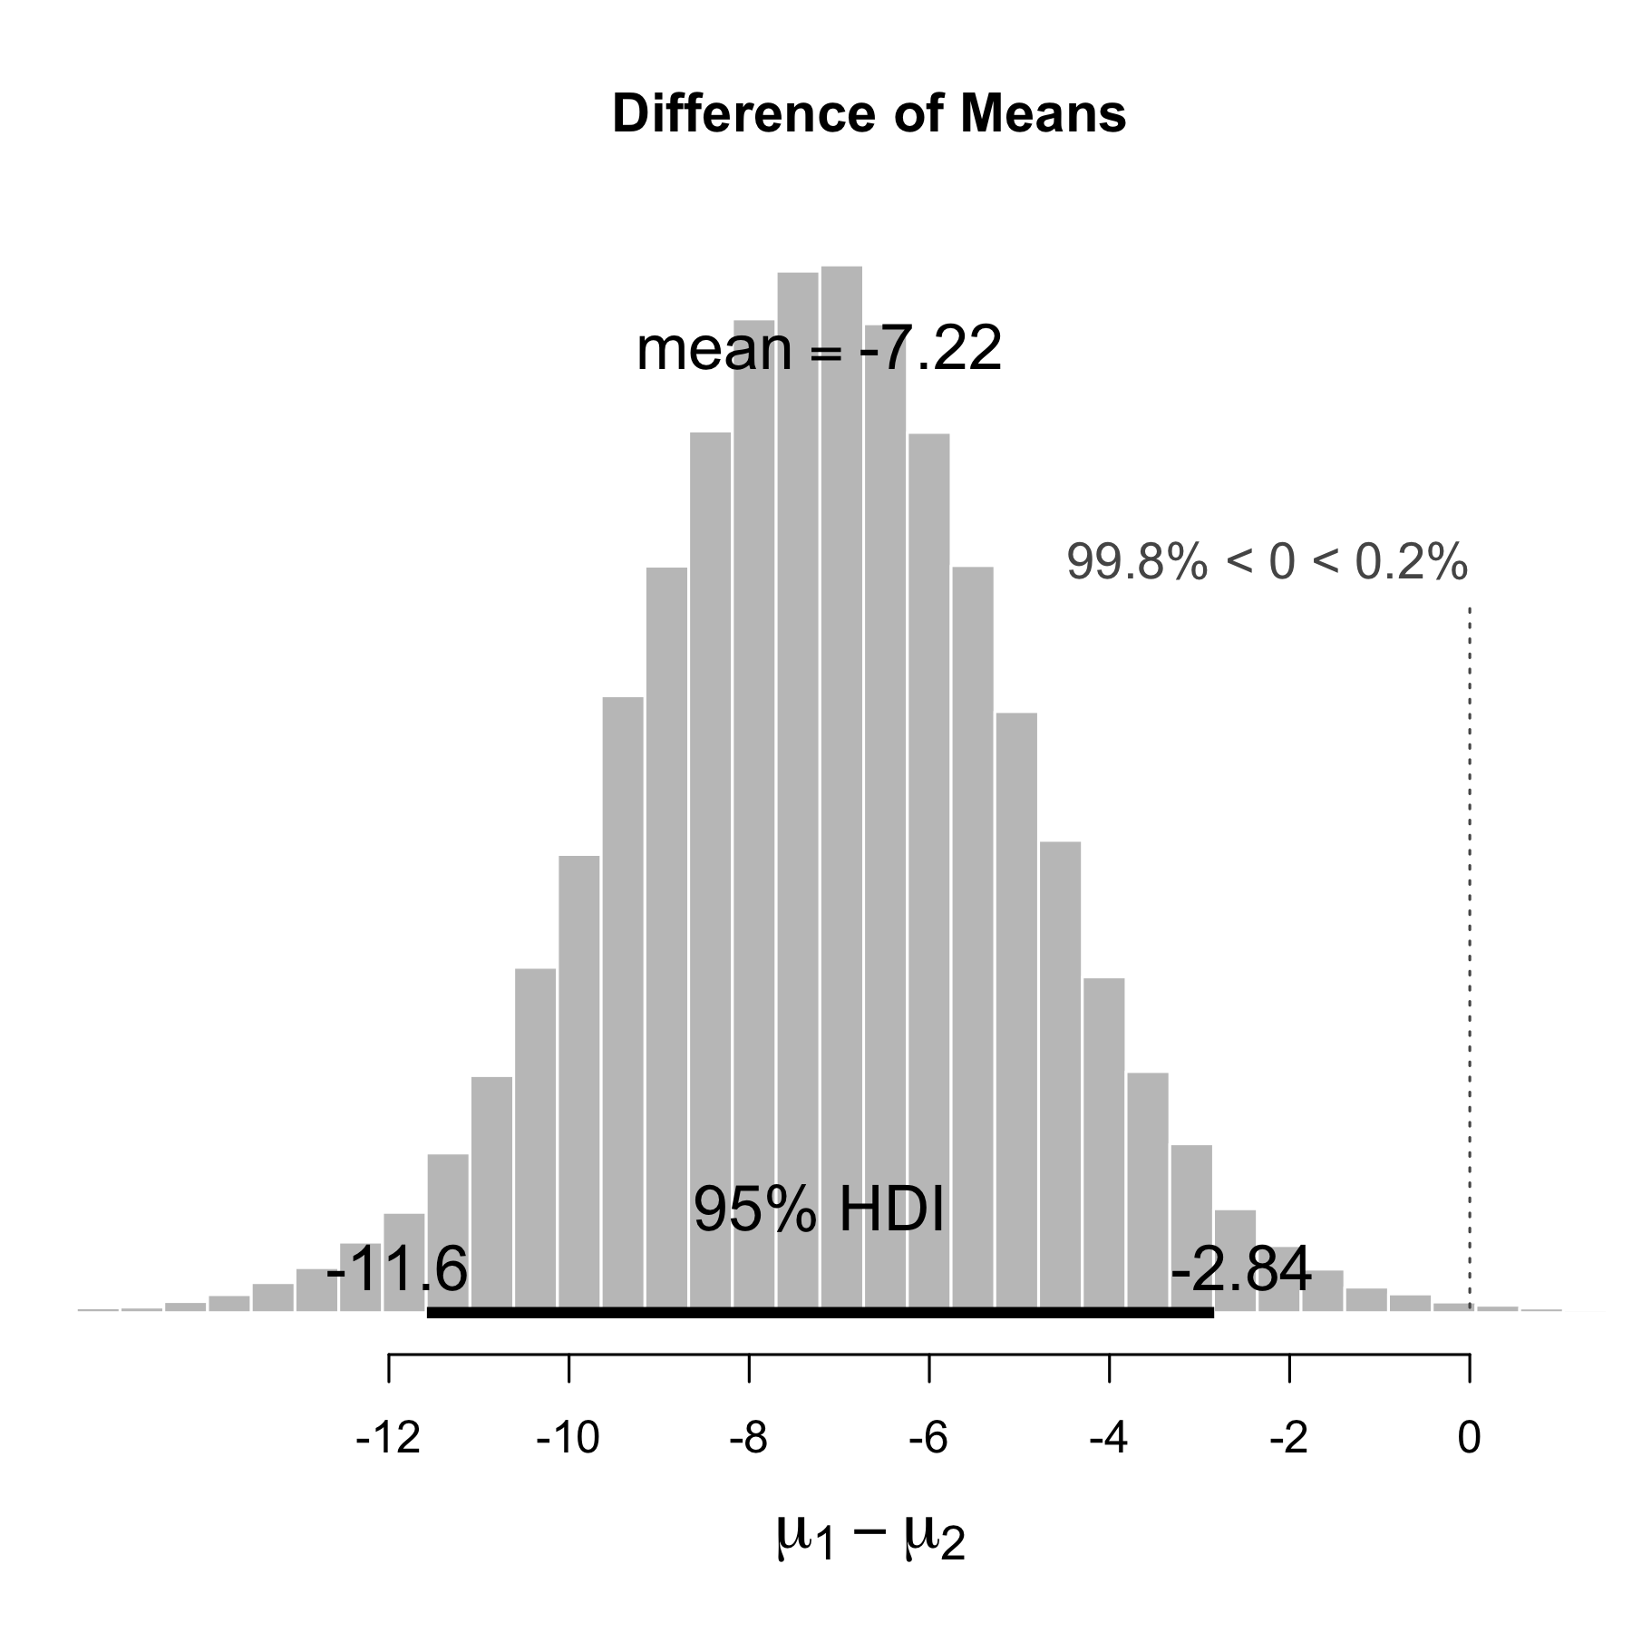
The MCMC Robot Walks Through a Landscape of Mean Differences
The output on the right shows the results of a Markov Chain-Monte Carlo analysis of mean differences between automatic and manual transmissions.
The MCMC “robot” took 100,000 steps through a landscape of possible mean differences.
For each proposed step, the robot examined the mtcars data to see if it seemed to be headed in the right direction.
The result is a posterior distribution of possible values for the mean difference. What’s the most likely posterior value?

Slide 10
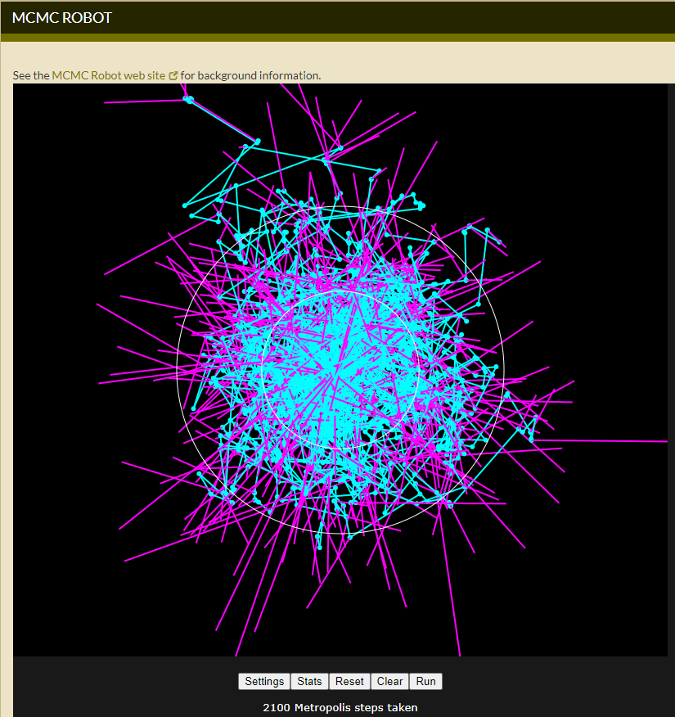
https://phylogeny.uconn.edu/mcmc-robot/#

Slide 11
Accept or Reject a Candidate Value Based on its Likelihood in the Proposal Distribution
target <- rnorm(1, 0, sd=sigma) # Draw one value from a proposal normal distribution
can <- x + target # Candidate value links to previous value: Makes it a Markov Chain
# Acceptance probability as the min of 1 or the ratio of density values of candidate and x.
aprob <- min(1, dnorm(can, mean=mu, sd=sigma)/dnorm(x, mean=mu, sd=sigma))
# Accept/reject the candidate value by
# comparing to a random draw from uniform(0, 1)
if (aprob >= runif(1)) { x <- can }
vec[i] <- x # Either keep the old x or use the new value depending upon the previous test
The relative probability in favor of the candidate instead of the previous value (x).
Notes:
# IST777 - Demonstration of Metropolis-Hastings Algorithm
# Using a Markov chain to build a normal distribution.
# Modified from code developed by David Kaplan
# install.packages("pastecs")
# install.packages("coda")
require(pastecs) # For time series descriptives
require(coda)
# n Chooses the overall chain size. Should be in excess of 1000 for good results
# burnin Choose the initial length of the chain that will be ignored
# mu Sets the target mean of the distribution
MetroHastingsNormal <- function (n, burnin, mu, sigma)
{
# 1. Define a numeric vector of length n and set the first value to the target center of the distribution
vec <- vector("numeric", n)
x <- mu
vec[1] <- x
for (i in 2:n) {
# Draw one value from a proposal normal distribution with mean 0 and sd as defined by the argument
target <- rnorm(1, 0, sd=sigma)
# Define a candidate value as the value of the target plus the previous value
can <- x + target # Candidate links to previous value: This is what makes it a time series
# Define the acceptance probability "aprob" as the minimum value of 1 or the
# ratio of the density values of candidate value and x. To the extent that
# the candidate "fits better" into the target distribution, it will be kept.
aprob <- min(1, dnorm(can, mean=mu, sd=sigma)/dnorm(x, mean=mu, sd=sigma))
# Decide to accept or reject the candidate value by comparing aprob to a random
# draw from a uniform(0, 1) distribution. Choose the candidate value if the
# relative probability is higher than the random value.
if (aprob >= runif(1)) { x <- can }
vec[i] <- x # Either keep the old x or use the new value depending upon the previous test
}
summary <- stat.desc(vec[burnin:n], basic=F)
print(summary)
# Show a trace plot and a histogram of the chain
hist(vec[burnin:n],30,main="Histogram of Post Burnin Values",xlab=NULL)
plot(ts(vec[burnin:n]),main="Trace Plot of Post Burnin Values")
}
hist(iris$Sepal.Width)
swmean <- mean(iris$Sepal.Width)
swsd <- sd(iris$Sepal.Width)
swmean; swsd
MetroHastingsNormal(n=10000, burnin=1000, mu=swmean, sigma=swsd)

Slide 12
Results of 10,000 Candidates (less 1000 burnin)
median mean var std.dev
3.057871002 3.057546233 0.192490420 0.438737302
Original data: Mean: 3.057333; SD: 0.4358663

Slide 13
Breakout 1 – JagsBreakoutExercise.R

Slide 14
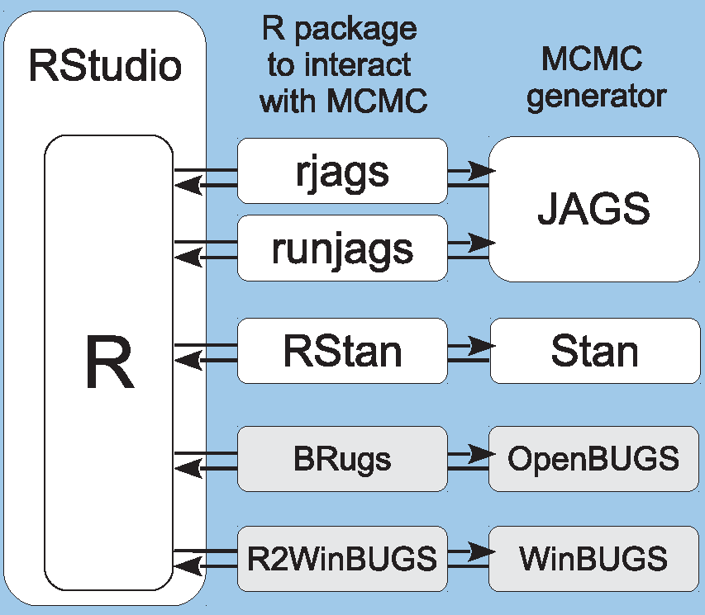
Fun With rjags
rjags is the interface between R and JAGS
JAGS – Just another Gibbs sampler – is a variant on the BUGS language that was developed to facilitate MCMC analysis of unknown distributions
John Kruschke uses BUGS and JAGS in his detailed book on Bayesian analysis
Image credit: J. Kruschke

Slide 15
JAGS is a Model Building Language
In this simple model, we want to find a posterior distribution for mu and sigma squared based on a normal prior for mu, a uniform prior for sigma-squared, and observed data modeled as normal.
model{
for (i in 1:n){
y[i] ~ dnorm(beta.0, tau.sq)
}
beta.0 ~ dnorm(0 , 0.0001 )
tau.sq <- 1/sigma.sq
sigma.sq ~ dunif (0 , 100)
}
Here we are modeling the observations as normal.
This sets the distribution for the priors on mu.
This sets the distribution for the priors on sigma squared.
Notes:
# Jags Tutorial - For IST772/777
# Where is the JAGS model file?
setwd("~/Dropbox/Teaching/Statistics/WeekByWeekLive/Week5")
# Make sure JAGS is installed for native OS
# along with these packages:
# install.packages("rjags")
# install.packages("MCMCvis")
library("rjags")
set.seed(1)
n <- 100
beta.0 <- 0 # This is the center of the prior for the mean
sigma.sq <- 5 # This is the prior for the variance
y <- rnorm(n, beta.0, sqrt(sigma.sq)) # Make some data to model with those parms
hist(y); mean(y); sd(y); var(y)
data <- list(y = y, n = n) # Prepare data to go to jags
inits <- list(beta.0 = beta.0, sigma.sq = sigma.sq) # Priors for the run
# n.chains - Number of separate MCMC chains to run
# n.adapt - Number of initial samples not counted in chain (inital samples may be used to set
# step size, e.g., for Metropolis-Hastings)
jags.m <- jags.model(file = "simpleDist.jags", data = data,
inits = inits, n.chains = 3, n.adapt = 100)
# This is a complex object full of code. The rest of the work is
# done in R.
View(jags.m)
# These are the parameters for which we want to see output.
params <- c("beta.0", "sigma.sq")
samps <- coda.samples(jags.m, params, n.iter = 10000)
# Note that the trace plots show separate colors for each chain.
# The chains should "mix" - that is they should converge with each
# other from a distributional standpoint.
plot(samps)
# These commands give diagnostics on the quality of the separate chains.
gelman.diag(samps) # Factors of one mean that between-chain and within-chain variance are equal
gelman.plot(samps)
# Rule of thumb: values of 1.1 or less show adequate convergence
burn.in <- 1000 # Provides an initial set of samples that will be ignored
summary(window(samps, start = burn.in))
library(MCMCvis) # Package for visualizing MCMC results
MCMCsummary(samps, round=3)
MCMCtrace(samps, pdf=FALSE)
####################################################
# Now do two independent means
x <- mtcars$mpg[mtcars$am==0]
y <- mtcars$mpg[mtcars$am==1]
# Where is the JAGS model file?
setwd("~/Dropbox/Teaching/Statistics/WeekByWeekLive/Week5")
# Set up the priors
mean_mu = mean(c(x, y)) # Set the means
precision_mu = 1 / (mad( c(x, y) )^2 * 1000000) # Precision is inverse of variance
sigmaLow = mad( c(x, y) ) / 1000 # mad is mean absolute deviation
sigmaHigh = mad( c(x, y) ) * 1000
inits_list <- list(
mu_x = mean(x), mu_y = mean(y),
sigma_x = mad(x), sigma_y = mad(y),
nuMinusOne = 4)
data_list <- list(
x = x, y = y,
mean_mu = mean_mu,
precision_mu = precision_mu,
sigmaLow = sigmaLow,
sigmaHigh = sigmaHigh)
# The parameters to monitor.
params <- c("mu_x", "mu_y", "mu_diff", "sigma_x", "sigma_y", "sigma_diff",
"nu", "eff_size", "x_pred", "y_pred")
# Run the model
model <- jags.model("two_indep_means.jags.txt", data = data_list,
inits = inits_list, n.chains = 3, n.adapt=1000)
update(model, 1000) # Length of the burn in samples
samples <- coda.samples(model, params, n.iter=10000)
# Inspecting the posterior
plot(samples)
summary(samples)
# The bandwidth is calculated by 1.06 times the
# minimum of the standard deviation and the interquartile range
# divided by 1.34 times the sample size to the negative one fifth power
plot(samples[,"mu_diff"])
####################################################
# Now do two independent means with a simpler model
library(rjags)
x <- mtcars$mpg[mtcars$am==0]
y <- mtcars$mpg[mtcars$am==1]
# Where is the JAGS model file?
setwd("~/Dropbox/Research/BayesReanalysis")
# Set up the priors
mean_mu = mean(c(x, y)) # Set the means
precision_mu = 1 / (mad( c(x, y) )^2 * 1000000) # Precision is inverse of variance
sigmaLow = mad( c(x, y) ) / 1000 # mad is mean absolute deviation
sigmaHigh = mad( c(x, y) ) * 1000
inits_list <- list(
mu_x = mean(x), mu_y = mean(y),
sigma_x = mad(x), sigma_y = mad(y),
nuMinusOne = 4)
data_list <- list(
x = x, y = y,
mean_mu = mean_mu,
precision_mu = precision_mu,
sigmaLow = sigmaLow,
sigmaHigh = sigmaHigh)
# The parameters to monitor.
params <- c("mu_x", "mu_y", "mu_diff", "sigma_x", "sigma_y", "sigma_diff",
"nu", "eff_size")
# Run the model
model <- jags.model("simple_2_indep_means.jags.txt", data = data_list,
inits = inits_list, n.chains = 3, n.adapt=1000)
update(model, 1000) # Length of the burn in samples
samples <- coda.samples(model, params, n.iter=10000)
# Inspecting the posterior
plot(samples)
summary(samples)
# The bandwidth is calculated by 1.06 times the
# minimum of the standard deviation and the interquartile range
# divided by 1.34 times the sample size to the negative one fifth power
plot(samples[,"mu_diff"])

Slide 16
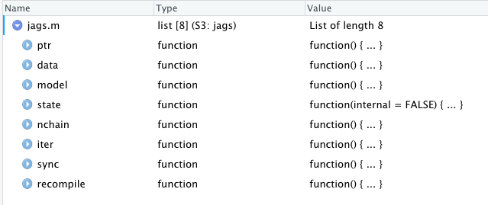
The JAGS Object Returned to R
A complex, nested data object consisting of operational parameters and R code to conduct MCMC sampling.

Slide 17
MCMC results from n=100 observations of y
y <- rnorm(n=100, mean=0, sd=5)
mean(y); sd(y); var(y)
[1] 0.2434796
[1] 2.008435
[1] 4.03381
Beta.0 is our model for mu and sigma.sq is our model for sigma squared.

Slide 18
Breakout 2 – RjagsExploration2.R

Slide 19
Plot Explorations
In the BEST package the plotAll() command draws diagnostic plots for a variety of aspects of the Bayesian estimation
The following slides explain some of that output
The whole display as produced by R appears in the next slide, followed by several slides that focus on particular parameters

Slide 20
The histograms to the left show the means from each of the 100,000 MCMC simulations for each of the two groups. The X-axis is calibrated identically between the two histograms to simplify the visual comparison.
For all of these histograms, the dark line on the X-axis shows the extent of the “highest density interval.” Each HDI represents the 95% of the possibilities for the posterior distribution of the given parameter, in this case the means.
The histogram above shows the difference between the group means for each of the 100,000 MCMC simulations.

Slide 21
The BEST procedure also models the standard deviations for each of the 100,000 MCMC simulation runs. As a result, we can also compare SDs between the two groups. The difference in SDs is modeled in the histogram below.
Does the HDI for the difference in SDs overlap with zero? Is there a credible difference between the SDs of the two groups?

Slide 22
For each of the 100,000 MCMC simulation runs, the BEST procedure calculates an index analogous to df, notated below as the log (base 10) of “nu.”
What we are looking for is values of log10(nu) that are in the region of 1.5. To the extent that the HDI of this display does NOT overlap with 1.5, there may be severe non-normality. The BEST procedure is robust against non-normality whereas the classical t-test is not.
The histogram below models the “effect size” of each of the simulation runs. Effect size is calculated as Cohen’s D, which is simply the difference in means divided by the pooled standard deviation (a kind of average SD across the two groups).
If the effect size HDI does not overlap with zero, this is suggestive of a credible difference between means. Remembering that Cohen’s D is calibrated in SDs, anything with an absolute value > 0.8 is considered a large effect.

Slide 23
These displays provide a diagnostic showing whether it is appropriate to be using the BEST procedure. The blue curves show a random sample of plots of the posterior t distribution for each group, using the mean, SD, and normality coefficient generated by a particular run of the MCMC process. The red histogram is the actual sample data.
To the extent that data are highly multi-modal or weirdly distributed, the t-distribution may be a bad fit.
For example, the rightmost category (30-35) in the Data Group 2 histogram could be a second mode for these data. With only n=13 observations, however, there is not enough data to really say for sure. In the absence of other anomalies, this is not a severe enough problem to raise a concern.

Slide 24
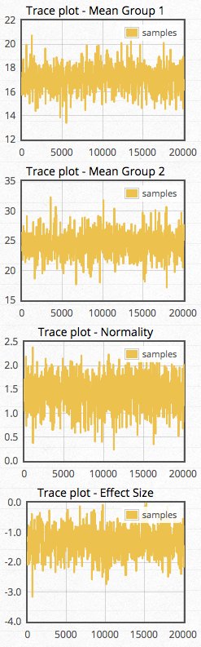
These trace plots do not appear in the plotAll() output from BESTmcmc(), but they do appear on Rasmus Baath’s webpage. We will also see examples of these trace plots later in the course.
Each trace plot represents the same data that you saw in the HDI histograms on previous pages, but rather than displaying them as a histogram, they show as a time series.
RB’s webpage defaults to 20,000 MCMC simulations. For each simulation run, the various parameters generated for that step in the robot’s path are displayed as a new dot just to the right of the previous dot. You can watch these unfold in real time as the Javascript processes your data.
RB says that these should look like a hairy caterpillar. We want to see roughly equal variation around a reasonably stable mean (for the topmost plot about 17 mpg) throughout the whole run (post burn-in), with just a few small spikes here and there.

Slide 25
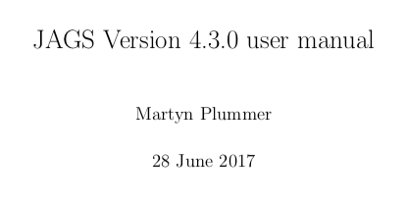
Paper of the Week – Plummer 2017
The JAGS language is not difficult to understand if you know R
Martin Plummer worked on the implementation of JAGS that we use and he wrote the manual
You can explore the manual to learn more about the JAGS models we explored in this class and to develop your own models

Slide 26
Homework and Practice Exam
Make sure you are using the updated syllabus that I distributed at the beginning of the semester (on the wall and in the handouts folder).
The second practice exam can be found in the handouts folder. I recommend that you try to complete the practice exam in an hour.
I will post the key on Wednesday.
Feel free to submit your exam file to the LMS if you are unsure about any of your answers.
The homework for week five is exercises 6 through 10 on pages 86 and 87.
Erratum in Week 6 asynch material: On the second page of section 6.6 one of the choices states: Region between 2.5% quantile and 95% quantile.It should be labeled: Region between 2.5% quantile and 97.5% quantile

